Slide 1
Data Mining
Chapter 5
Association Analysis: Basic Concepts
Introduction to Data Mining, 2nd Edition
by
Tan, Steinbach, Karpatne, Kumar

Slide 2
Association Rule Mining
Given a set of transactions, find rules that will predict the occurrence of an item based on the occurrences of other items in the transaction
Market-Basket transactions
Example of Association Rules
{Diaper} → {Beer}, {Milk, Bread} → {Eggs,Coke}, {Beer, Bread} → {Milk},
Implication means co-occurrence, not causality!

Slide 3
Definition: Frequent Itemset
Itemset
A collection of one or more items
Example: {Milk, Bread, Diaper}
k-itemset
An itemset that contains k items
Support count (σ)
Frequency of occurrence of an itemset
E.g. σ({Milk, Bread,Diaper}) = 2
Support
Fraction of transactions that contain an itemset
E.g. s({Milk, Bread, Diaper}) = 2/5
Frequent Itemset
An itemset whose support is greater than or equal to a minsup threshold

Slide 4
Definition: Association Rule
Association Rule
An implication expression of the form X → Y, where X and Y are itemsets
Example: {Milk, Diaper} → {Beer}
Rule Evaluation Metrics
Support (s)
Fraction of transactions that contain both X and Y
Confidence (c)
Measures how often items in Y appear in transactions that contain X
Example:

Slide 5
Association Rule Mining Task
Given a set of transactions T, the goal of association rule mining is to find all rules having
support ≥ minsup threshold
confidence ≥ minconf threshold
Brute-force approach:
List all possible association rules
Compute the support and confidence for each rule
Prune rules that fail the minsup and minconf thresholds
⇒ Computationally prohibitive!

Slide 6
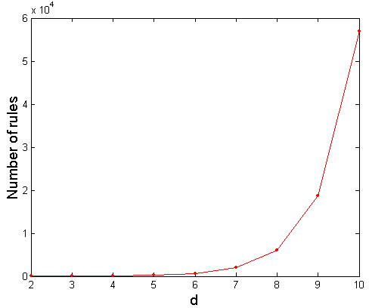
Computational Complexity
Given d unique items:
Total number of itemsets = 2^{d}
Total number of possible association rules:
If d=6, R = 602 rules

Slide 7
Mining Association Rules
Example of Rules:
{Milk,Diaper} → {Beer} (s=0.4, c=0.67) {Milk,Beer} → {Diaper} (s=0.4, c=1.0)
{Diaper,Beer} → {Milk} (s=0.4, c=0.67)
{Beer} → {Milk,Diaper} (s=0.4, c=0.67) {Diaper} → {Milk,Beer} (s=0.4, c=0.5)
{Milk} → {Diaper,Beer} (s=0.4, c=0.5)
Observations:
All the above rules are binary partitions of the same itemset: {Milk, Diaper, Beer}
Rules originating from the same itemset have identical support but can have different confidence
Thus, we may decouple the support and confidence requirements

Slide 8
Mining Association Rules
Two-step approach:
Frequent Itemset Generation
Generate all itemsets whose support ≥ minsup
Rule Generation
Generate high confidence rules from each frequent itemset, where each rule is a binary partitioning of a frequent itemset
Frequent itemset generation is still computationally expensive

Slide 9
Frequent Itemset Generation
Given d items, there are 2^{d} possible candidate itemsets

Slide 10
Frequent Itemset Generation
Brute-force approach:
Each itemset in the lattice is a candidate frequent itemset
Count the support of each candidate by scanning the database
Match each transaction against every candidate
Complexity ~ O(NMw) => Expensive since M = 2^{d} !!!

Slide 11
Frequent Itemset Generation Strategies
Reduce the number of candidates (M)
Complete search: M=2^{d}
Use pruning techniques to reduce M
Reduce the number of transactions (N)
Reduce size of N as the size of itemset increases
Used by DHP and vertical-based mining algorithms
Reduce the number of comparisons (NM)
Use efficient data structures to store the candidates or transactions
No need to match every candidate against every transaction

Slide 12
Reducing Number of Candidates
Apriori principle:
If an itemset is frequent, then all of its subsets must also be frequent
Apriori principle holds due to the following property of the support measure:
Support of an itemset never exceeds the support of its subsets
This is known as the anti-monotone property of support

Slide 13
Illustrating Apriori Principle
Found to be Infrequent
Pruned supersets

Slide 14
Illustrating Apriori Principle
Items (1-itemsets)
Minimum Support = 3
If every subset is considered,
⁶C₁ + ⁶C₂ + ⁶C₃
6 + 15 + 20 = 41
With support-based pruning,
6 + 6 + 4 = 16

Slide 15
Illustrating Apriori Principle
Items (1-itemsets)
Minimum Support = 3
If every subset is considered,
⁶C₁ + ⁶C₂ + ⁶C₃
6 + 15 + 20 = 41
With support-based pruning,
6 + 6 + 4 = 16

Slide 16
Illustrating Apriori Principle
Items (1-itemsets)
Pairs (2-itemsets)
(No need to generate candidates involving Coke or Eggs)
Minimum Support = 3
If every subset is considered,
⁶C₁ + ⁶C₂ + ⁶C₃
6 + 15 + 20 = 41
With support-based pruning,
6 + 6 + 4 = 16

Slide 17
Illustrating Apriori Principle
Items (1-itemsets)
Pairs (2-itemsets)
(No need to generate candidates involving Coke or Eggs)
Minimum Support = 3
If every subset is considered,
⁶C₁ + ⁶C₂ + ⁶C₃
6 + 15 + 20 = 41
With support-based pruning,
6 + 6 + 4 = 16

Slide 18
Illustrating Apriori Principle
Items (1-itemsets)
Pairs (2-itemsets)
(No need to generate candidates involving Coke or Eggs)
Minimum Support = 3
Triplets (3-itemsets)
If every subset is considered,
⁶C₁ + ⁶C₂ + ⁶C₃
6 + 15 + 20 = 41
With support-based pruning,
6 + 6 + 4 = 16

Slide 19
Illustrating Apriori Principle
Items (1-itemsets)
Pairs (2-itemsets)
(No need to generate candidates involving Coke or Eggs)
Minimum Support = 3
Triplets (3-itemsets)
If every subset is considered,
⁶C₁ + ⁶C₂ + ⁶C₃
6 + 15 + 20 = 41
With support-based pruning,
6 + 6 + 4 = 16
6 + 6 + 1 = 13

Slide 20
Apriori Algorithm
F_{k}: frequent k-itemsets
L_{k}: candidate k-itemsets
Algorithm
Let k=1
Generate F₁ = {frequent 1-itemsets}
Repeat until F_{k} is empty
Candidate Generation: Generate L_{k+1} from F_{k}
Candidate Pruning: Prune candidate itemsets in L_{k+1} containing subsets of length k that are infrequent
Support Counting: Count the support of each candidate in L_{k+1} by scanning the DB
Candidate Elimination: Eliminate candidates in L_{k+1} that are infrequent, leaving only those that are frequent => F_{k+1}

Slide 21
Candidate Generation: Brute-force method

Slide 22
Candidate Generation: Merge Fk-1 and F1 itemsets

Slide 23
Candidate Generation: Fk-1 x Fk-1 Method

Slide 24
Candidate Generation: F_{k-1} x F_{k-1} Method
Merge two frequent (k-1)-itemsets if their first (k-2) items are identical
F₃ = {ABC,ABD,ABE,ACD,BCD,BDE,CDE}
Merge(ABC, ABD) = ABCD
Merge(ABC, ABE) = ABCE
Merge(ABD, ABE) = ABDE
Do not merge(ABD,ACD) because they share only prefix of length 1 instead of length 2

Slide 25
Candidate Pruning
Let F₃ = {ABC,ABD,ABE,ACD,BCD,BDE,CDE} be the set of frequent 3-itemsets
L₄ = {ABCD,ABCE,ABDE} is the set of candidate 4-itemsets generated (from previous slide)
Candidate pruning
Prune ABCE because ACE and BCE are infrequent
Prune ABDE because ADE is infrequent
After candidate pruning: L₄ = {ABCD}

Slide 26
Alternate F_{k-1} x F_{k-1} Method
Merge two frequent (k-1)-itemsets if the last (k-2) items of the first one is identical to the first (k-2) items of the second.
F₃ = {ABC,ABD,ABE,ACD,BCD,BDE,CDE}
Merge(ABC, BCD) = ABCD
Merge(ABD, BDE) = ABDE
Merge(ACD, CDE) = ACDE
Merge(BCD, CDE) = BCDE

Slide 27
Candidate Pruning for Alternate F_{k-1} x F_{k-1} Method
Let F₃ = {ABC,ABD,ABE,ACD,BCD,BDE,CDE} be the set of frequent 3-itemsets
L₄ = {ABCD,ABDE,ACDE,BCDE} is the set of candidate 4-itemsets generated (from previous slide)
Candidate pruning
Prune ABDE because ADE is infrequent
Prune ACDE because ACE and ADE are infrequent
Prune BCDE because BCE
After candidate pruning: L₄ = {ABCD}

Slide 28
Illustrating Apriori Principle
Items (1-itemsets)
Pairs (2-itemsets)
(No need to generate candidates involving Coke or Eggs)
Minimum Support = 3
Triplets (3-itemsets)
If every subset is considered,
⁶C₁ + ⁶C₂ + ⁶C₃
6 + 15 + 20 = 41
With support-based pruning,
6 + 6 + 1 = 13
Use of F_{k-1}xF_{k-1} method for candidate generation results in
only one 3-itemset. This is eliminated after the support counting step.

Slide 29
Support Counting of Candidate Itemsets
Scan the database of transactions to determine the support of each candidate itemset
Must match every candidate itemset against every transaction, which is an expensive operation

Slide 30
Support Counting of Candidate Itemsets
To reduce number of comparisons, store the candidate itemsets in a hash structure
Instead of matching each transaction against every candidate, match it against candidates contained in the hashed buckets

Slide 31
Support Counting: An Example
Suppose you have 15 candidate itemsets of length 3:
{1 4 5}, {1 2 4}, {4 5 7}, {1 2 5}, {4 5 8}, {1 5 9}, {1 3 6}, {2 3 4}, {5 6 7}, {3 4 5}, {3 5 6}, {3 5 7}, {6 8 9}, {3 6 7}, {3 6 8}
How many of these itemsets are supported by transaction (1,2,3,5,6)?

Slide 32
Support Counting Using a Hash Tree
Suppose you have 15 candidate itemsets of length 3:
{1 4 5}, {1 2 4}, {4 5 7}, {1 2 5}, {4 5 8}, {1 5 9}, {1 3 6}, {2 3 4}, {5 6 7}, {3 4 5}, {3 5 6}, {3 5 7}, {6 8 9}, {3 6 7}, {3 6 8}
You need:
Hash function
Max leaf size: max number of itemsets stored in a leaf node (if number of candidate itemsets exceeds max leaf size, split the node)
Hash function
2 3 4
5 6 7
3,6,9
1,4,7
1 4 5
3 4 5
3 5 6
3 5 7
6 8 9
3 6 7
3 6 8
1 3 6
2,5,8
1 2 4
4 5 7
1 2 5
4 5 8
1 5 9

Slide 33
Support Counting Using a Hash Tree
Hash Function
Candidate Hash Tree
1,4,7
3,6,9
2,5,8
2 3 4
5 6 7
1 4 5
1 3 6
3 4 5
3 5 6
3 6 7
Hash on 1, 4 or 7
3 5 7
3 6 8
1 2 4
1 5 9
6 8 9
1 2 5
4 5 7
4 5 8

Slide 34
Support Counting Using a Hash Tree
Hash Function
Candidate Hash Tree
1,4,7
3,6,9
2,5,8
2 3 4
5 6 7
1 4 5
1 3 6
3 4 5
3 5 6
3 6 7
Hash on 2, 5 or 8
3 5 7
3 6 8
1 2 4
1 5 9
6 8 9
1 2 5
4 5 7
4 5 8

Slide 35
Support Counting Using a Hash Tree
Hash Function
Candidate Hash Tree
1,4,7
3,6,9
2,5,8
2 3 4
5 6 7
1 4 5
1 3 6
3 4 5
3 5 6
3 6 7
Hash on 3, 6 or 9
3 5 7
3 6 8
1 2 4
1 5 9
6 8 9
1 2 5
4 5 7
4 5 8

Slide 36
Support Counting Using a Hash Tree
1 2 3 5 6
transaction
Hash Function
1 +
2 3 5 6
2 +
3 5 6
1,4,7
3,6,9
3 +
5 6
2,5,8
2 3 4
5 6 7
1 4 5
1 3 6
3 4 5
3 5 6
3 6 7
3 5 7
3 6 8
1 2 4
1 2 5
1 5 9
6 8 9
4 5 7
4 5 8

Slide 37
Support Counting Using a Hash Tree
1 2 3 5 6
transaction
Hash Function
1 +
2 3 5 6
2 +
3 5 6
1,4,7
3,6,9
1 2 +
3 5 6
3 +
5 6
2,5,8
1 3 +
5 6
2 3 4
1 5 +
6
5 6 7
1 4 5
1 3 6
3 4 5
3 5 6
3 6 7
3 5 7
3 6 8
1 2 4
1 2 5
1 5 9
6 8 9
4 5 7
4 5 8

Slide 38
Support Counting Using a Hash Tree
1 2 3 5 6
transaction
Hash Function
1 +
2 3 5 6
2 +
3 5 6
1,4,7
3,6,9
1 2 +
3 5 6
3 +
5 6
2,5,8
1 3 +
5 6
2 3 4
1 5 +
6
5 6 7
1 4 5
1 3 6
3 4 5
3 5 6
3 6 7
3 5 7
3 6 8
1 2 4
1 2 5
1 5 9
6 8 9
4 5 7
4 5 8
Match transaction against 11 out of 15 candidates

Slide 39
Rule Generation
Given a frequent itemset L, find all non-empty subsets f ⊂ L such that f → L – f satisfies the minimum confidence requirement
If {A,B,C,D} is a frequent itemset, candidate rules:
ABC →D, ABD →C, ACD →B, BCD →A, A →BCD, B →ACD, C →ABD, D →ABC AB →CD, AC → BD, AD → BC, BC →AD, BD →AC, CD →AB,
If |L| = k, then there are 2^{k} – 2 candidate association rules (ignoring L → ∅ and ∅ → L)

Slide 40
Rule Generation
In general, confidence does not have an anti-monotone property
c(ABC →D) can be larger or smaller than c(AB →D)
But confidence of rules generated from the same itemset has an anti-monotone property
E.g., Suppose {A,B,C,D} is a frequent 4-itemset: c(ABC → D) ≥ c(AB → CD) ≥ c(A → BCD)
Confidence is anti-monotone w.r.t. number of items on the RHS of the rule

Slide 41
Rule Generation for Apriori Algorithm
Lattice of rules
Low Confidence Rule
Pruned Rules

Slide 42
Association Analysis: Basic Concepts and Algorithms
Algorithms and Complexity
© Tan,Steinbach, Kumar Introduction to Data Mining 03/24/2006 42

Slide 43
Factors Affecting Complexity of Apriori
Choice of minimum support threshold
lowering support threshold results in more frequent itemsets
this may increase number of candidates and max length of frequent itemsets
Dimensionality (number of items) of the data set
more space is needed to store support count of each item
if number of frequent items also increases, both computation and I/O costs may also increase
Size of database
since Apriori makes multiple passes, run time of algorithm may increase with number of transactions
Average transaction width
transaction width increases with denser data sets
This may increase max length of frequent itemsets and traversals of hash tree (number of subsets in a transaction increases with its width)

Slide 44
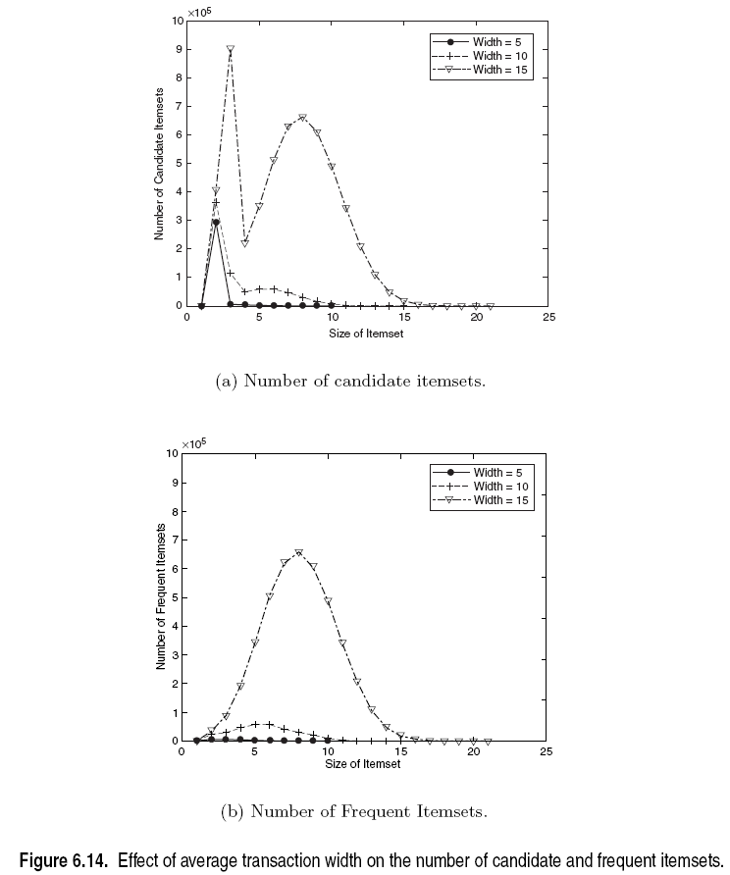
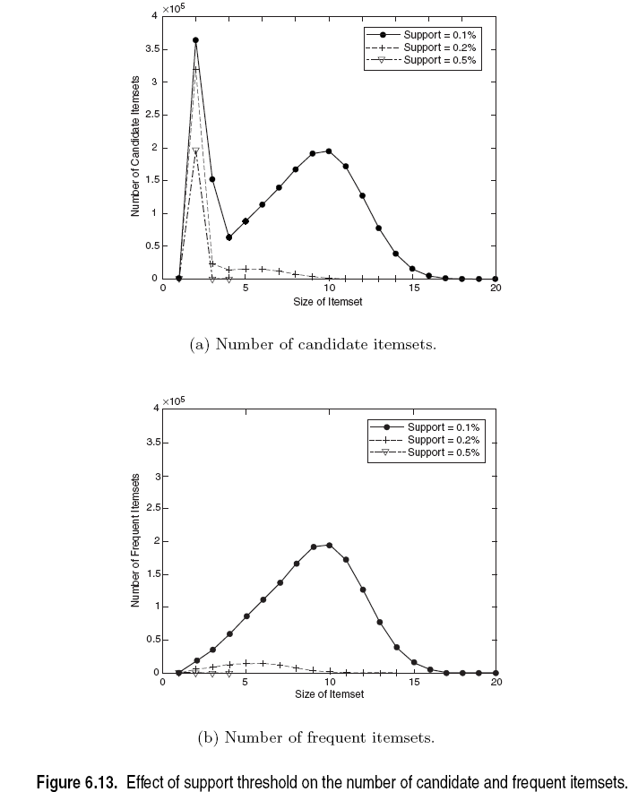
Factors Affecting Complexity of Apriori

Slide 45
Compact Representation of Frequent Itemsets
Some itemsets are redundant because they have identical support as their supersets
Number of frequent itemsets
Need a compact representation

Slide 46
Maximal Frequent Itemset
An itemset is maximal frequent if it is frequent and none of its immediate supersets is frequent
Maximal Itemsets
Infrequent Itemsets
Border

Slide 47
What are the Maximal Frequent Itemsets in this Data?
Minimum support threshold = 5

Slide 48
An illustrative example
Items
 | A | B | C | D | E | F | G | H | I | J
1
2
3
4
5
6
7
8
9
10
Support threshold (by count) : 5
Frequent itemsets: ?
Transactions

Slide 49
An illustrative example
Items
 | A | B | C | D | E | F | G | H | I | J
1
2
3
4
5
6
7
8
9
10
Support threshold (by count) : 5
Frequent itemsets: {F}
Transactions

Slide 50
An illustrative example
Items
 | A | B | C | D | E | F | G | H | I | J
1
2
3
4
5
6
7
8
9
10
Support threshold (by count) : 5
Frequent itemsets: {F}
Support threshold (by count): 4
Frequent itemsets: ?
Transactions

Slide 51
An illustrative example
Items
 | A | B | C | D | E | F | G | H | I | J
1
2
3
4
5
6
7
8
9
10
Support threshold (by count) : 5
Frequent itemsets: {F}
Support threshold (by count): 4
Frequent itemsets: {E}, {F}, {E,F}, {J}
Transactions

Slide 52
An illustrative example
Items
 | A | B | C | D | E | F | G | H | I | J
1
2
3
4
5
6
7
8
9
10
Support threshold (by count) : 5
Frequent itemsets: {F}
Support threshold (by count): 4
Frequent itemsets: {E}, {F}, {E,F}, {J}
Support threshold (by count): 3
Frequent itemsets: ?
Transactions

Slide 53
An illustrative example
Items
 | A | B | C | D | E | F | G | H | I | J
1
2
3
4
5
6
7
8
9
10
Support threshold (by count) : 5
Frequent itemsets: {F}
Support threshold (by count): 4
Frequent itemsets: {E}, {F}, {E,F}, {J}
Support threshold (by count): 3
Frequent itemsets:
All subsets of {C,D,E,F} + {J}
Transactions

Slide 54
An illustrative example
Items
 | A | B | C | D | E | F | G | H | I | J
1
2
3
4
5
6
7
8
9
10
Support threshold (by count) : 5
Frequent itemsets: {F}
Maximal itemsets: ?
Support threshold (by count): 4
Frequent itemsets: {E}, {F}, {E,F}, {J}
Maximal itemsets: ?
Support threshold (by count): 3
Frequent itemsets:
All subsets of {C,D,E,F} + {J}
Maximal itemsets: ?
Transactions

Slide 55
An illustrative example
Items
 | A | B | C | D | E | F | G | H | I | J
1
2
3
4
5
6
7
8
9
10
Support threshold (by count) : 5
Frequent itemsets: {F}
Maximal itemsets: {F}
Support threshold (by count): 4
Frequent itemsets: {E}, {F}, {E,F}, {J}
Maximal itemsets: ?
Support threshold (by count): 3
Frequent itemsets:
All subsets of {C,D,E,F} + {J}
Maximal itemsets: ?
Transactions

Slide 56
An illustrative example
Items
 | A | B | C | D | E | F | G | H | I | J
1
2
3
4
5
6
7
8
9
10
Support threshold (by count) : 5
Frequent itemsets: {F}
Maximal itemsets: {F}
Support threshold (by count): 4
Frequent itemsets: {E}, {F}, {E,F}, {J}
Maximal itemsets: {E,F}, {J}
Support threshold (by count): 3
Frequent itemsets:
All subsets of {C,D,E,F} + {J}
Maximal itemsets: ?
Transactions

Slide 57
An illustrative example
Items
 | A | B | C | D | E | F | G | H | I | J
1
2
3
4
5
6
7
8
9
10
Support threshold (by count) : 5
Frequent itemsets: {F}
Maximal itemsets: {F}
Support threshold (by count): 4
Frequent itemsets: {E}, {F}, {E,F}, {J}
Maximal itemsets: {E,F}, {J}
Support threshold (by count): 3
Frequent itemsets:
All subsets of {C,D,E,F} + {J}
Maximal itemsets:
{C,D,E,F}, {J}
Transactions

Slide 58
Another illustrative example
Items
 | A | B | C | D | E | F | G | H | I | J
1
2
3
4
5
6
7
8
9
10
Support threshold (by count) : 5
Maximal itemsets: {A}, {B}, {C}
Support threshold (by count): 4
Maximal itemsets: {A,B}, {A,C},{B,C}
Support threshold (by count): 3
Maximal itemsets: {A,B,C}
Transactions

Slide 59
Closed Itemset
An itemset X is closed if none of its immediate supersets has the same support as the itemset X.
X is not closed if at least one of its immediate supersets has support count as X.

Slide 60
Maximal vs Closed Itemsets
Transaction Ids
Not supported by any transactions

Slide 61
Maximal vs Closed Frequent Itemsets
Minimum support = 2
Closed but not maximal
Closed and maximal
# Closed = 9
# Maximal = 4

Slide 62
What are the Closed Itemsets in this Data?

Slide 63
Example 1
Items
 | A | B | C | D | E | F | G | H | I | J
1
2
3
4
5
6
7
8
9
10
Itemsets | Support (counts) | Closed itemsets
{C} | 3
{D} | 2
{C,D} | 2
Transactions

Slide 64
Example 1
Items
 | A | B | C | D | E | F | G | H | I | J
1
2
3
4
5
6
7
8
9
10
Itemsets | Support (counts) | Closed itemsets
{C} | 3 | ✓
{D} | 2
{C,D} | 2 | ✓
Transactions

Slide 65
Example 2
Items
 | A | B | C | D | E | F | G | H | I | J
1
2
3
4
5
6
7
8
9
10
Itemsets | Support (counts) | Closed itemsets
{C} | 3
{D} | 2
{E} | 2
{C,D} | 2
{C,E} | 2
{D,E} | 2
{C,D,E} | 2
Transactions

Slide 66
Example 2
Items
 | A | B | C | D | E | F | G | H | I | J
1
2
3
4
5
6
7
8
9
10
Itemsets | Support (counts) | Closed itemsets
{C} | 3 | ✓
{D} | 2
{E} | 2
{C,D} | 2
{C,E} | 2
{D,E} | 2
{C,D,E} | 2 | ✓
Transactions

Slide 67
Example 3
Items
 | A | B | C | D | E | F | G | H | I | J
1
2
3
4
5
6
7
8
9
10
Closed itemsets: {C,D,E,F}, {C,F}
Transactions

Slide 68
Example 4
Items
 | A | B | C | D | E | F | G | H | I | J
1
2
3
4
5
6
7
8
9
10
Closed itemsets: {C,D,E,F}, {C}, {F}
Transactions

Slide 69
Maximal vs Closed Itemsets

Slide 70
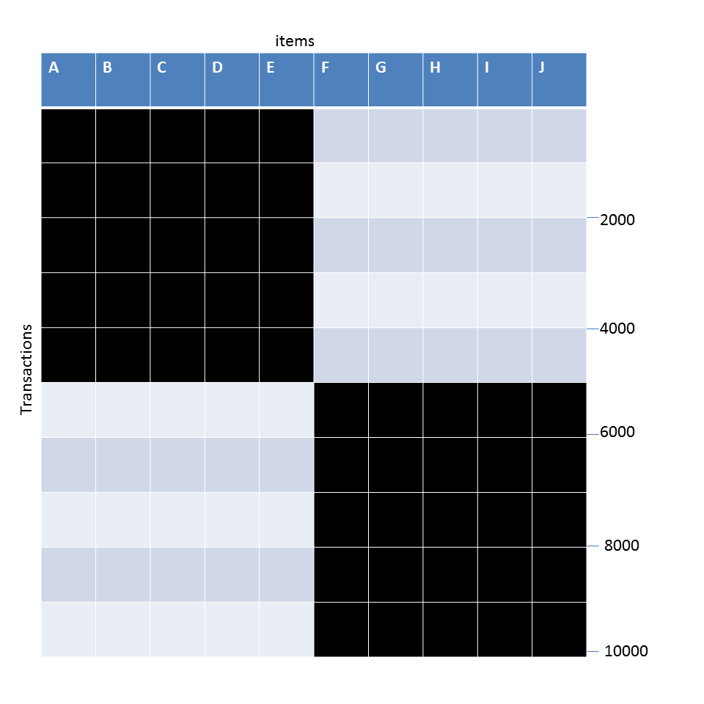
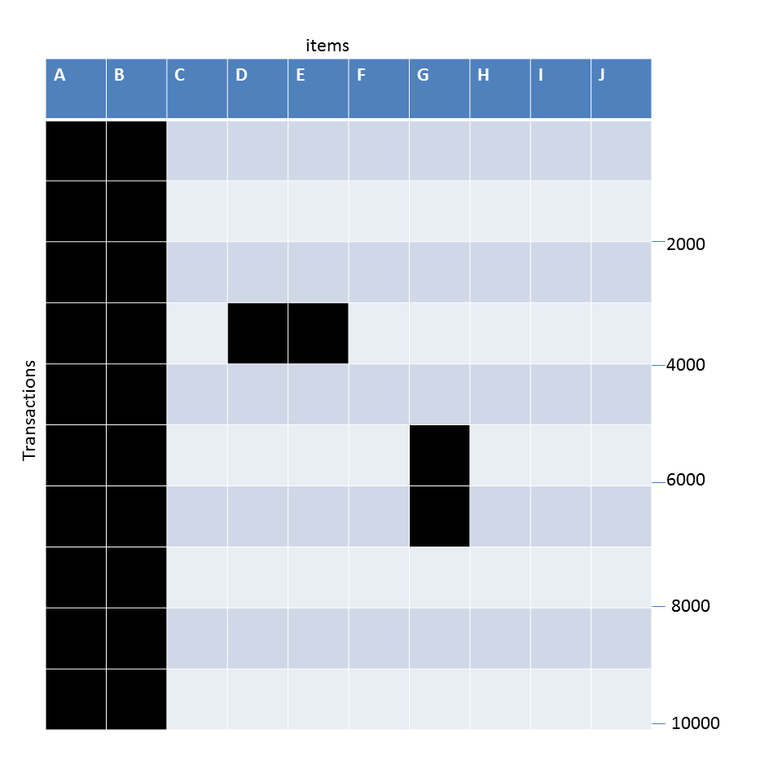
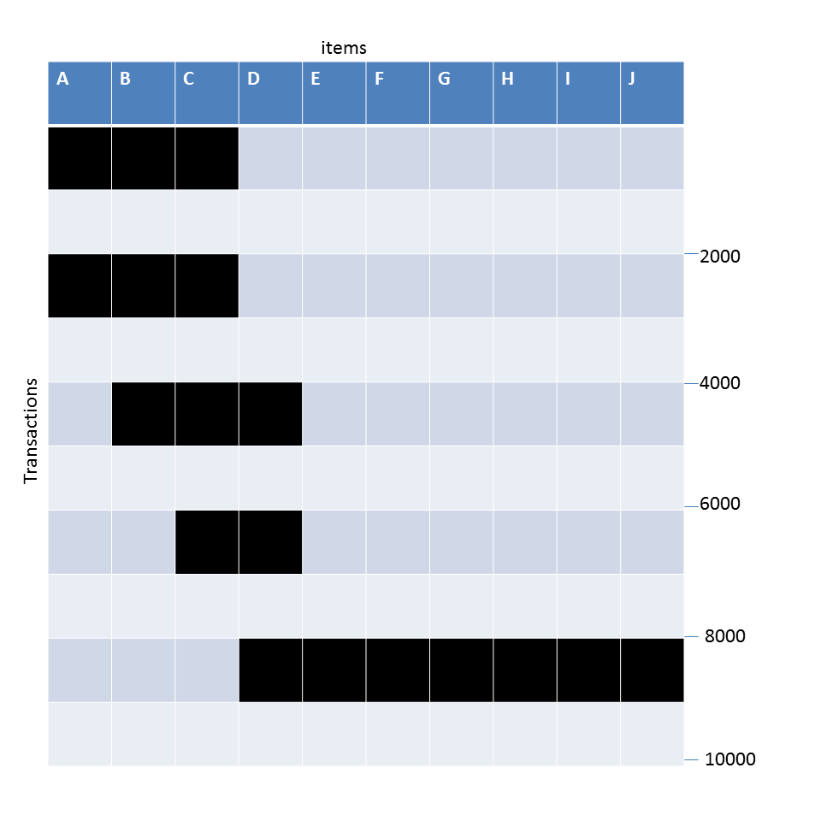
Example question
Given the following transaction data sets (dark cells indicate presence of an item in a transaction) and a support threshold of 20%, answer the following questions
What is the number of frequent itemsets for each dataset? Which dataset will produce the most number of frequent itemsets?
Which dataset will produce the longest frequent itemset?
Which dataset will produce frequent itemsets with highest maximum support?
Which dataset will produce frequent itemsets containing items with widely varying support levels (i.e., itemsets containing items with mixed support, ranging from 20% to more than 70%)?
What is the number of maximal frequent itemsets for each dataset? Which dataset will produce the most number of maximal frequent itemsets?
What is the number of closed frequent itemsets for each dataset? Which dataset will produce the most number of closed frequent itemsets?

Slide 71
Pattern Evaluation
Association rule algorithms can produce large number of rules
Interestingness measures can be used to prune/rank the patterns
In the original formulation, support & confidence are the only measures used

Slide 72
Computing Interestingness Measure
Given X → Y or {X,Y}, information needed to compute interestingness can be obtained from a contingency table
Contingency table
 | Y | Y
X | f₁₁ | f₁₀ | f₁₊
X | f₀₁ | f₀₀ | f_{o+}
 | f₊₁ | f₊₀ | N
f₁₁: support of X and Y f₁₀: support of X and Y f₀₁: support of X and Y f₀₀: support of X and Y
Used to define various measures
support, confidence, Gini, entropy, etc.

Slide 73
Drawback of Confidence
Customers | Tea | Coffee | …
C1 | 0 | 1 | …
C2 | 1 | 0 | …
C3 | 1 | 1 | …
C4 | 1 | 0 | …
…
 | Coffee | Coffee
Tea | 15 | 5 | 20
Tea | 75 | 5 | 80
 | 90 | 10 | 100
Association Rule: Tea → Coffee
Confidence ≅ P(Coffee|Tea) = 15/20 = 0.75
Confidence > 50%, meaning people who drink tea are more likely to drink coffee than not drink coffee
So rule seems reasonable

Slide 74
Drawback of Confidence
 | Coffee | Coffee
Tea | 15 | 5 | 20
Tea | 75 | 5 | 80
 | 90 | 10 | 100
Association Rule: Tea → Coffee
Confidence= P(Coffee|Tea) = 15/20 = 0.75
but P(Coffee) = 0.9, which means knowing that a person drinks tea reduces the probability that the person drinks coffee!
Note that P(Coffee|Tea) = 75/80 = 0.9375

Slide 75
Measure for Association Rules
So, what kind of rules do we really want?
Confidence(X → Y) should be sufficiently high
To ensure that people who buy X will more likely buy Y than not buy Y
Confidence(X → Y) > support(Y)
Otherwise, rule will be misleading because having item X actually reduces the chance of having item Y in the same transaction
Is there any measure that capture this constraint?
Answer: Yes. There are many of them.

Slide 76
Statistical Independence
The criterion confidence(X → Y) = support(Y)
is equivalent to:
P(Y|X) = P(Y)
P(X,Y) = P(X) × P(Y)
If P(X,Y) > P(X) × P(Y) : X & Y are positively correlated
If P(X,Y) < P(X) × P(Y) : X & Y are negatively correlated

Slide 77
Measures that take into account statistical dependence
lift is used for rules while interest is used for itemsets

Slide 78
Example: Lift/Interest
 | Coffee | Coffee
Tea | 15 | 5 | 20
Tea | 75 | 5 | 80
 | 90 | 10 | 100
Association Rule: Tea → Coffee
Confidence= P(Coffee|Tea) = 0.75
but P(Coffee) = 0.9
Lift = 0.75/0.9= 0.8333 (< 1, therefore is negatively associated)
So, is it enough to use confidence/lift for pruning?

Slide 79
Lift or Interest
 | Y | Y
X | 10 | 0 | 10
X | 0 | 90 | 90
 | 10 | 90 | 100
 | Y | Y
X | 90 | 0 | 90
X | 0 | 10 | 10
 | 90 | 10 | 100
Statistical independence:
If P(X,Y)=P(X)P(Y) => Lift = 1

Slide 80
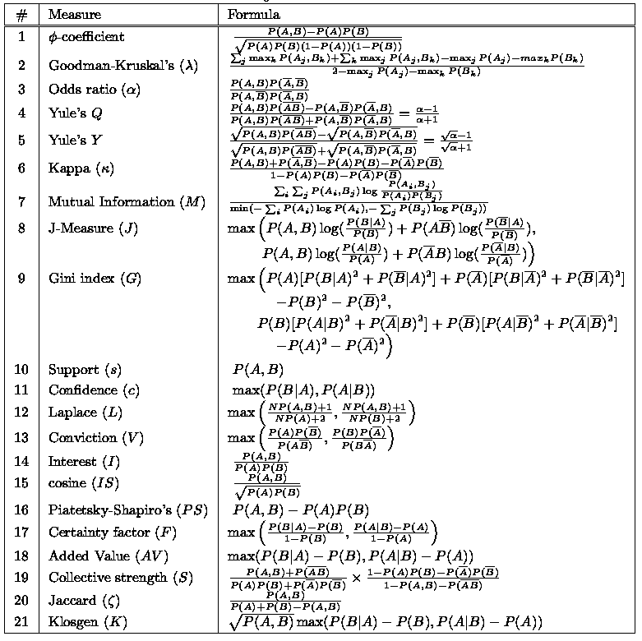
There are lots of measures proposed in the literature

Slide 81
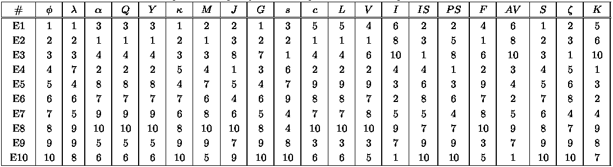
Comparing Different Measures
10 examples of contingency tables:
Rankings of contingency tables using various measures:

Slide 82
Property under Variable Permutation
Does M(A,B) = M(B,A)?
Symmetric measures:
support, lift, collective strength, cosine, Jaccard, etc
Asymmetric measures:
confidence, conviction, Laplace, J-measure, etc

Slide 83
Property under Row/Column Scaling
Grade-Gender Example (Mosteller, 1968):
 | Female | Male
High | 2 | 3 | 5
Low | 1 | 4 | 5
 | 3 | 7 | 10
 | Female | Male
High | 4 | 30 | 34
Low | 2 | 40 | 42
 | 6 | 70 | 76
2x
10x
Mosteller: Underlying association should be independent of the relative number of male and female students in the samples

Slide 84
Property under Inversion Operation
Transaction 1
.
.
.
.
.
Transaction N

Slide 85
Example: φ-Coefficient
φ-coefficient is analogous to correlation coefficient for continuous variables
 | Y | Y
X | 60 | 10 | 70
X | 10 | 20 | 30
 | 70 | 30 | 100
 | Y | Y
X | 20 | 10 | 30
X | 10 | 60 | 70
 | 30 | 70 | 100
φ Coefficient is the same for both tables

Slide 86
Property under Null Addition
Invariant measures:
support, cosine, Jaccard, etc
Non-invariant measures:
correlation, Gini, mutual information, odds ratio, etc

Slide 87
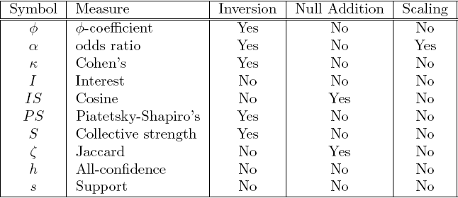
Different Measures have Different Properties

Slide 88
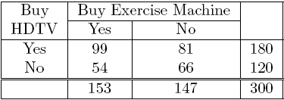
Simpson’s Paradox
=> Customers who buy HDTV are more likely to buy exercise machines

Slide 89
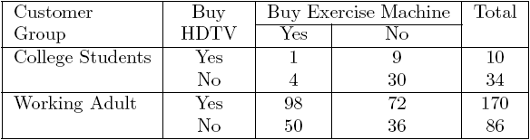
Simpson’s Paradox
College students:
Working adults:

Slide 90
Simpson’s Paradox
Observed relationship in data may be influenced by the presence of other confounding factors (hidden variables)
Hidden variables may cause the observed relationship to disappear or reverse its direction!
Proper stratification is needed to avoid generating spurious patterns

Slide 91
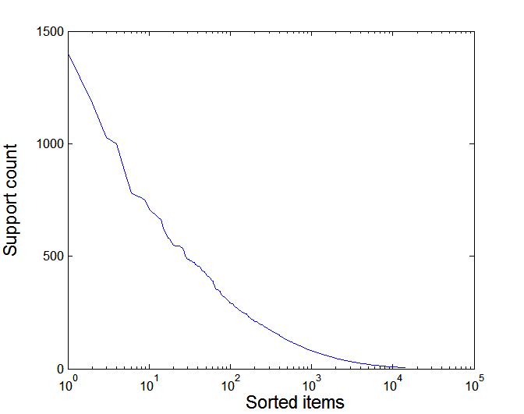
Effect of Support Distribution on Association Mining
Few items with high support
Many items with low support
Support distribution of a retail data set
Rank of item (in log scale)
Many real data sets have skewed support distribution

Slide 92
Effect of Support Distribution
Difficult to set the appropriate minsup threshold
If minsup is too high, we could miss itemsets involving interesting rare items (e.g., {caviar, vodka})
If minsup is too low, it is computationally expensive and the number of itemsets is very large

Slide 93
Cross-Support Patterns
A cross-support pattern involves items with varying degree of support
Example: {caviar,milk}
How to avoid such patterns?
caviar
milk

Slide 94
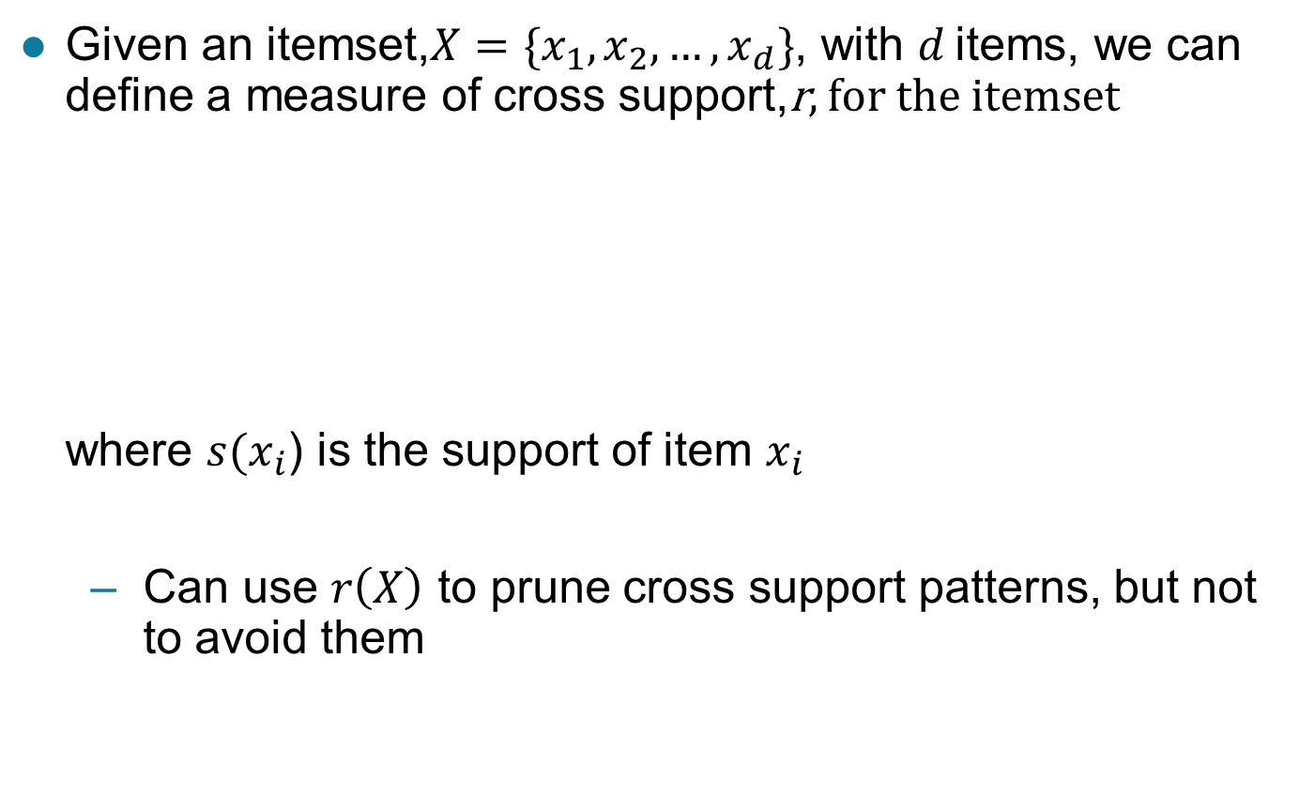
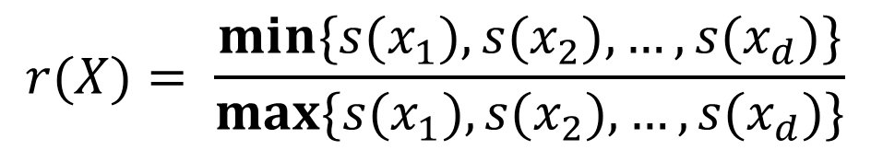
A Measure of Cross Support
$$r(X)= \frac{min\{s(x_{1}),s(x_{2}), …,s(x_{d})\}}{max\{s(x_{1}),s(x_{2}), …,s(x_{d})\}}$$
Given an itemset,$X=\{x_{1},x_{2},…,x_{d}\}$, with $d$ items, we can define a measure of cross support,r, for the itemset where $s(x_{i}$) is the support of item $x_{i}$
Can use $r\left(X\right)$ to prune cross support patterns, but not to avoid them

Slide 95
Confidence and Cross-Support Patterns
Observation:
conf(caviar→milk) is very high
but
conf(milk→caviar) is very low
Therefore,
min( conf(caviar→milk), conf(milk→caviar) ) is also very low
caviar
milk

Slide 96
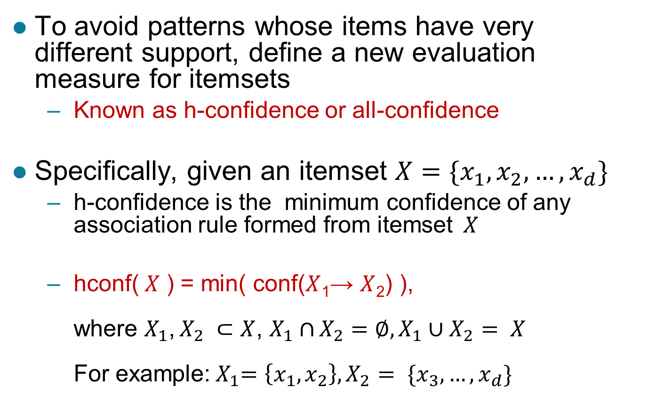
H-Confidence
To avoid patterns whose items have very different support, define a new evaluation measure for itemsets
Known as h-confidence or all-confidence
Specifically, given an itemset $X=\{x_{1},x_{2},…,x_{d}\}$
h-confidence is the minimum confidence of any association rule formed from itemset$X$
hconf($X$ ) = min( conf($X$₁→ $X$₂) ), where $X_{1}$, $X_{2} ⊂$ $X$, $X_{1}∩$ $X_{2}=∅,X_{1}∪X_{2}$ $= X$ For example:${ X}_{1}=\left\{x_{1},x_{2}\right\}, X_{2}$ $= \{x_{3},…,x_{d}\}$

Slide 97
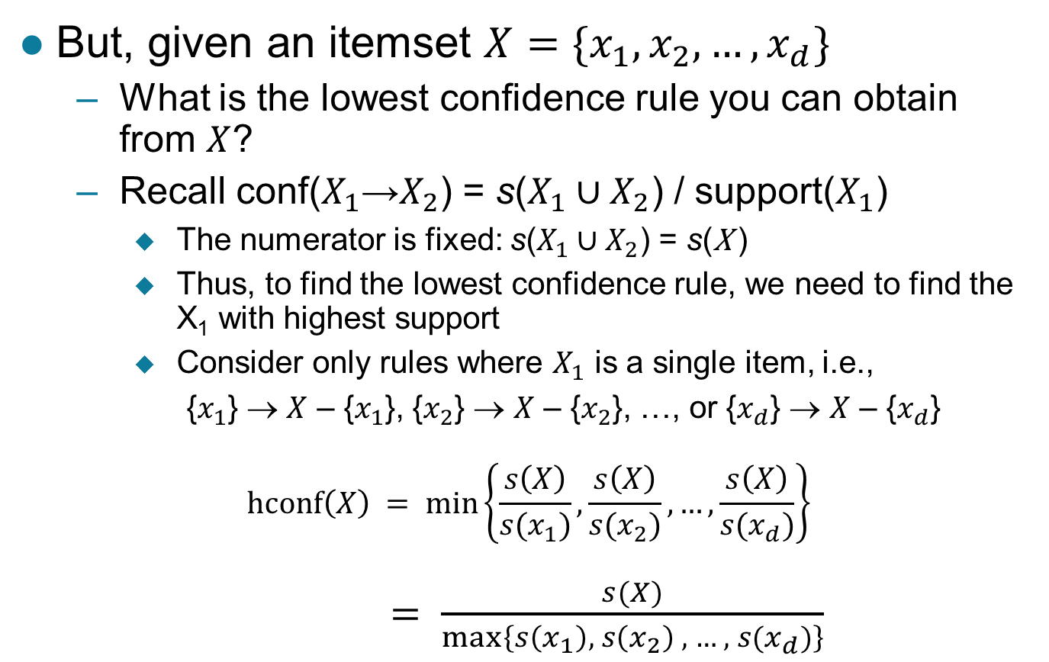
H-Confidence …
But, given an itemset $X=\{x_{1},x_{2},…,x_{d}\}$
What is the lowest confidence rule you can obtain from $X$?
Recall conf($X_{1}$→$X_{2}$) = s($X_{1}∪X_{2}$) / support($X_{1}$)
The numerator is fixed: s($X_{1}∪X_{2}$) = s(X )
Thus, to find the lowest confidence rule, we need to find the X₁ with highest support
Consider only rules where $X_{1}$ is a single item, i.e.,
{$x_{1}$} → $X$ – {$x_{1}$}, {$x_{2}$} → $X$ – {$x_{2}$}, …, or {$x_{d}$} → $X$ – {$x_{d}$}
$$hconf\left(X\right) = min\left\{\frac{s\left(X\right)}{s(x_{1})},\frac{s\left(X\right)}{s(x_{2})},…,\frac{s\left(X\right)}{s(x_{d})}\right\}$$ $= \frac{s(X)}{max⁡\left\{s\left(x_{1}\right), s\left(x_{2}\right) , …, s(x_{d})\right\}}$

Slide 98
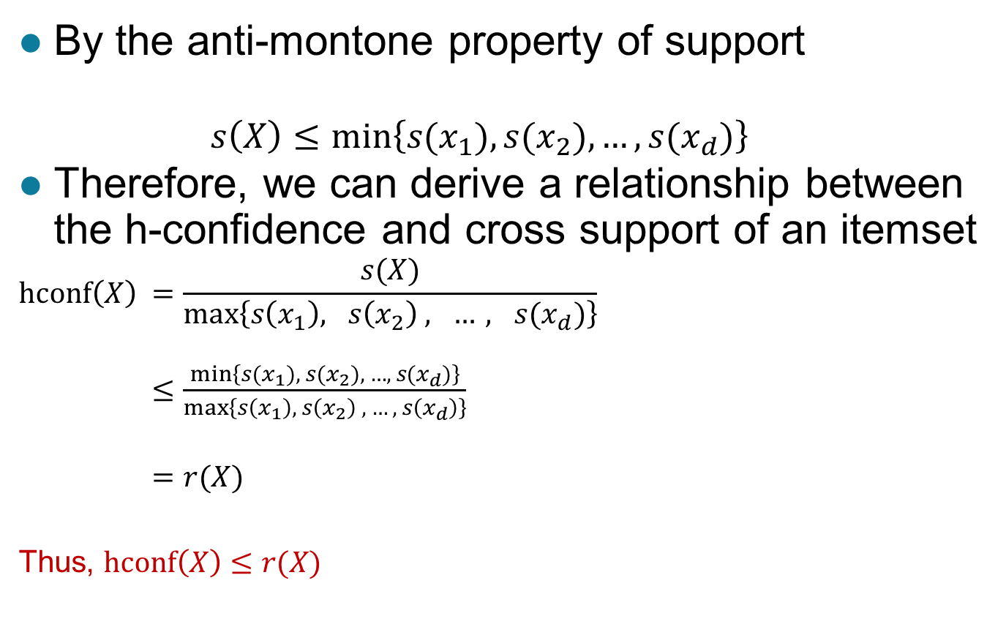
Cross Support and H-confidence
By the anti-montone property of support
$$s\left(X\right)≤min\left\{s(x_{1}),{s(x}_{2}), …,{s(x}_{d})\right\}$$
Therefore, we can derive a relationship between the h-confidence and cross support of an itemset
$$hconf\left(X\right) =\frac{s(X)}{max⁡\left\{s\left(x_{1}\right), s\left(x_{2}\right) , …, s(x_{d})\right\}}$$ $≤\frac{min\left\{s(x_{1}),{ s(x}_{2}), …,{ s(x}_{d})\right\}}{\max\left\{s\left(x_{1}\right), s\left(x_{2}\right) , …, s\left(x_{d}\right)\right\}}$
$=r(X)$
Thus, $hconf\left(X\right)≤r(X)$

Slide 99
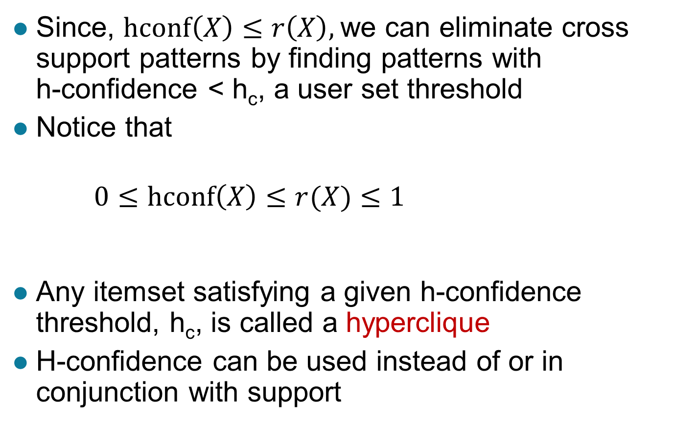
Cross Support and H-confidence …
Since, $hconf\left(X\right)≤r\left(X\right),$we can eliminate cross support patterns by finding patterns with h-confidence < h_{c}, a user set threshold
Notice that
$0≤hconf\left(X\right)≤r(X)≤1$
Any itemset satisfying a given h-confidence threshold, h_{c}, is called a hyperclique
H-confidence can be used instead of or in conjunction with support

Slide 100
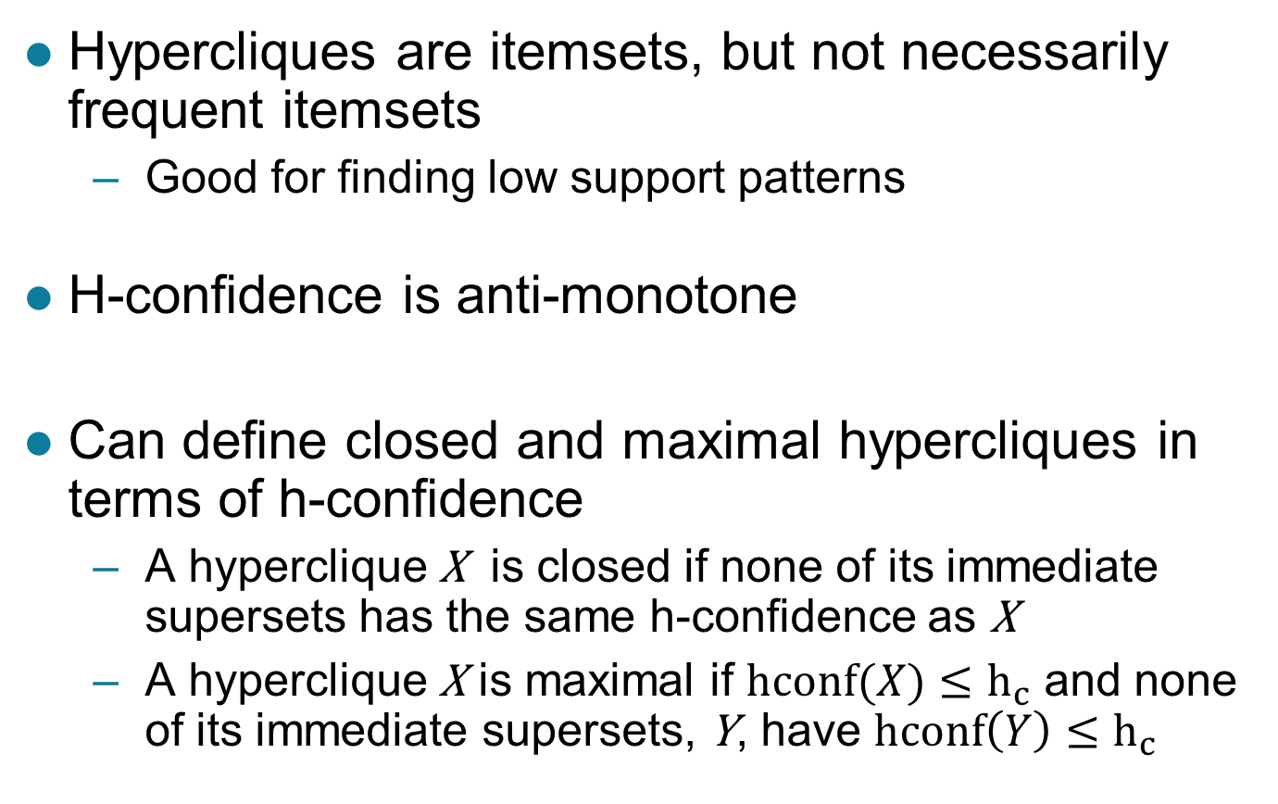
Properties of Hypercliques
Hypercliques are itemsets, but not necessarily frequent itemsets
Good for finding low support patterns
H-confidence is anti-monotone
Can define closed and maximal hypercliques in terms of h-confidence
A hyperclique X is closed if none of its immediate supersets has the same h-confidence as X
A hyperclique X is maximal if $hconf(X)≤h_{c}$ and none of its immediate supersets, Y, have $hconf\left(Y\right)≤h_{c}$

Slide 101
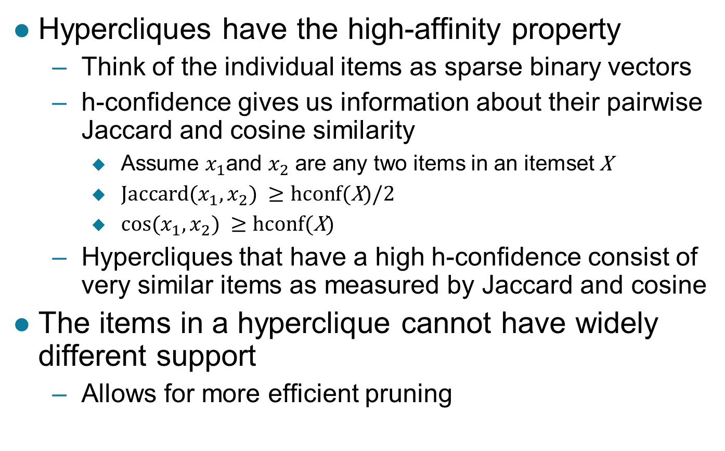
Properties of Hypercliques …
Hypercliques have the high-affinity property
Think of the individual items as sparse binary vectors
h-confidence gives us information about their pairwise Jaccard and cosine similarity
Assume $x_{1}$and $x_{2}$ are any two items in an itemset X
${Jaccard⁡(x}_{1},x_{2}) ≥hcon$f(X)/2
${cos⁡(x}_{1},x_{2}) ≥hcon$f(X)
Hypercliques that have a high h-confidence consist of very similar items as measured by Jaccard and cosine
The items in a hyperclique cannot have widely different support
Allows for more efficient pruning

Slide 102
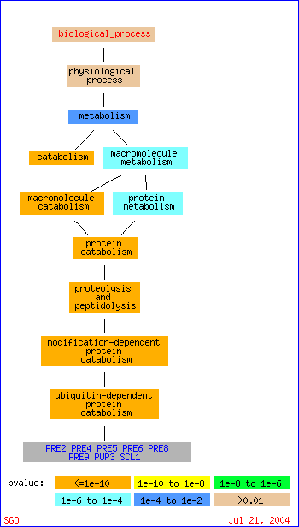
Example Applications of Hypercliques
Hypercliques are used to find strongly coherent groups of items
Words that occur together in documents
Proteins in a protein interaction network
In the figure at the right, a gene ontology hierarchy for biological process shows that the identified proteins in the hyperclique (PRE2, …, SCL1) perform the same function and are involved in the same biological process

